Slide 1
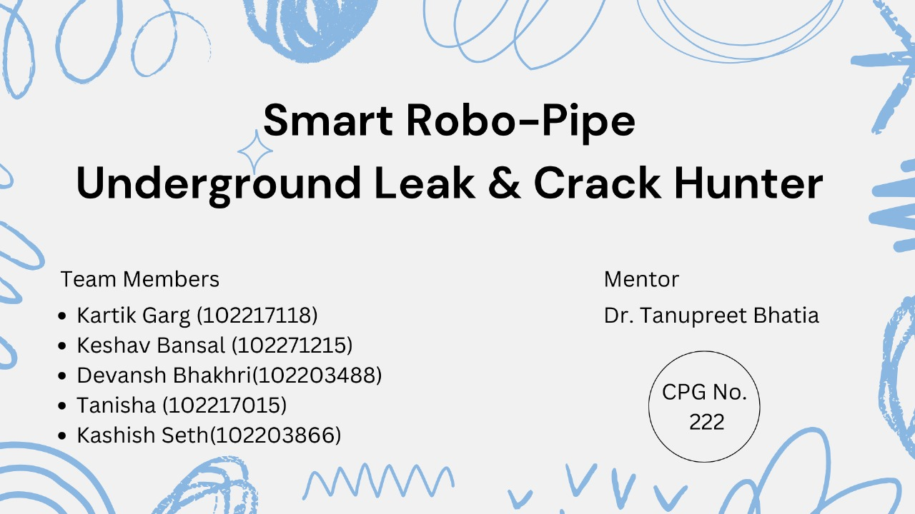

Slide 2
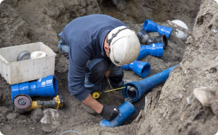
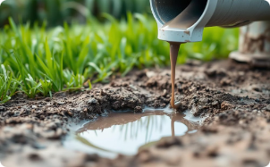
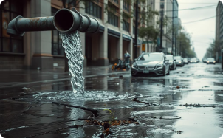
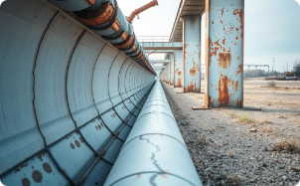

Problem Statement
Underground water pipelines suffer from undetected cracks and leakages, leading to water loss, structural damage, and high maintenance costs. Existing inspection methods are manual, inefficient, and lack real-time analysis. There is a need for an autonomous, AI-powered robot that can detect cracks and leaks accurately, store inspection data, and operate efficiently within fixed-size pipelines.
Need Analysis: Safeguarding Infrastructure & Environment
High Costs of Manual Inspection
Environmental Impact
Critical Infrastructure Risk
Aging Pipelines
Undetected leaks risk contaminating soil and harming delicate surrounding ecosystems.
Pipeline failures can cause severe service disruptions threatening community stability.
Traditional monitoring methods are slow and error-prone for our decades-old infrastructure.
Manual inspection is costly, time-consuming, and inefficient.

Slide 3
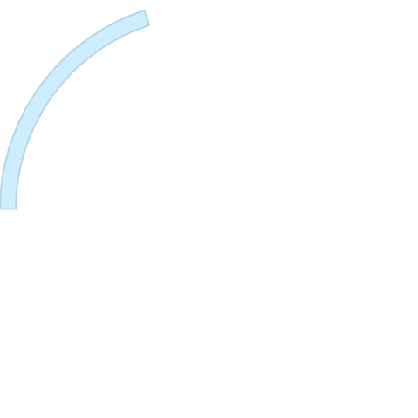




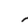
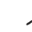
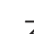


Literature Survey
Existing Systems
Introduction
Current robotic systems use cameras and sensors but lack real-time AI analysis.
Existing pipeline inspection methods rely on manual checks, leading to inefficiencies and delays.
Crack and Leakage Detection
Most robots use basic imaging without automated marking or real-time defect identification.
Data Storage & Processing
Current systems store raw inspection data but lack real-time computational analysis onboard.
Power & Backtracking
Most robots have limited battery life and lack efficient backtracking mechanisms.

Slide 4

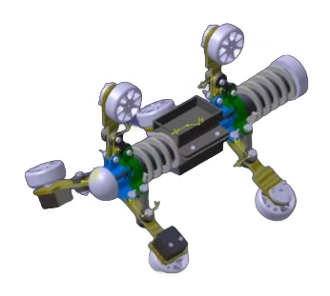


Project Overview: Revolutionizing Pipeline Monitoring
Autonomous Navigation
The robot moves inside a fixed-size underground pipeline using a triangular three-wheel configuration for stability.
Advanced Sensing
Utilizes three cameras for real-time crack detection and acoustic sensors for leakage analysis.
Real-Time Analysis
The robot analyzes data on the go, detecting leaks, structural weaknesses, and battery depletion to ensure seamless operation and proactive maintenance.

Slide 5
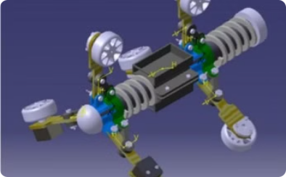
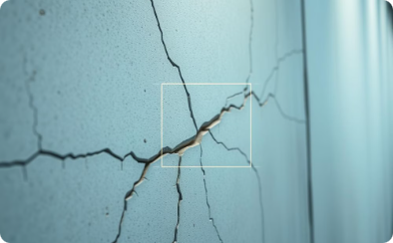
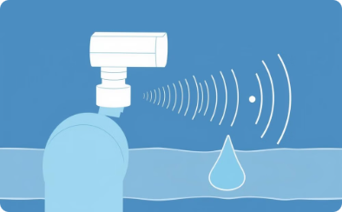
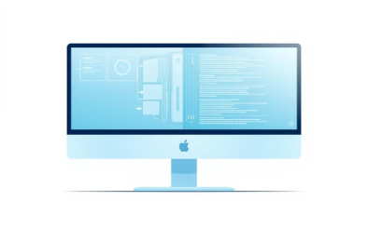
Project Objectives
Hardware Structure Build
Crack Detection Image Fusion Model
Leakage Detection Sound Wave Model
Hardware-Software Integration
Develop a robust and versatile hardware structure to enable reliable pipeline inspection and monitoring.
Deploy advanced computer vision techniques to accurately detect and map cracks in pipeline infrastructure.
Leverage acoustic sensors and signal processing to identify and locate pipeline leaks through sound wave analysis.
Seamlessly integrate the hardware and software components to create a comprehensive pipeline integrity solution.

Slide 6

Assumptions
1
Steady Water Flow
2
Clear Water
The water flow remains steady throughout the pipeline, ensuring a stable inspection environment.
The inspection is conducted in pipelines where water clarity allows effective detection of cracks
3
Controlled Testing Conditions
The robot operates in a controlled setting without extreme external factors affecting performance.
Constraints
1
No Sharp Edges
2
Limited Real-Time Processing
The pipeline structure does not have sharp edges that could obstruct the robot's movement.
The processing speed depends on the onboard computing capabilities of the system.
3
No bifercation or diversion
The robot is designed to operate in a single, continuous pipeline without diversions or branch points.

Slide 7





Project Execution Plan
Research and Planning (1 week)
Design and Development (3 weeks)
Software Development (2 weeks)
Conduct literature review
Design tri-wheel robot chassis
Implement AI-driven crack and leak detection.
Define scope and requirements
Integrate sensors, controller, and power system.
Plan hardware and software
Develop real-time data processing and storage mechanisms.
Develop movement and navigation systems
Optimize AI classification for enhanced defect detection accuracy.
Testing and Optimization (2 weeks)
Final Testing & Deployment (1 week)
Conduct controlled lab testing in a simulated pipeline environment.
Conduct final tests in real-world pipeline scenarios
Optimize battery efficiency, data storage, and AI processing speed.
Retrieve and analyze inspection data for performance evaluation
Validate crack and leak detection accuracy using various pipeline conditions.
Refine algorithms for maximum operational efficiency.

Slide 8
Methadology
1
Stable Triangular Wheel Structure
2
Data Acquisition & Sensing
Ensures smooth navigation and stability inside underground water pipelines.
Uses high-resolution endoscopic cameras for crack detection and microphones for leak identification.
3
Crack Detection Using AI
4
Acoustic-Based Leakage Detection
AI processes images in real-time, marking pipeline cracks for analysis.
Sensors analyze water flow. They detect leak signatures. It helps in locating leaks.
5
Real-Time Processing & Storage
6
Distance Estimation
Processes data on Raspberry Pi, storing only critical footage on an SD card.
A rotary encoder calculates the exact location of detected defects.
7
Motion Control and Backtracking
L298N motor driver ensures stable movement, and backtracking is enabled when necessary.

Slide 9
Project Requirements
Hardware Requirements
Software & AI Requirements
Development Platforms
Robotic Platform – Triangular three-wheel configuration for stability.
AI-Based Defect Detection – Identifies cracks and leaks using machine learning models.
Programming Languages – Python, C++ for AI and control logic.
Cameras (×3) – High-resolution imaging for crack detection.
Machine Learning Frameworks – TensorFlow, OpenCV for real-time video analysis.
Real-Time Data Processing – Continuously analyzes video and sensor data for defect detection inside the pipeline.
Acoustic Sensors – Detects water flow variations for leak detection.
Embedded Development Platforms – Raspberry Pi / Arduino for hardware control.
Microcontroller/Processor – Raspberry Pi for data processing.
Navigation Control System – Enables autonomous movement and backtracking.
Wheel Encoder – Measures distance traveled inside the pipeline.
SD Cards (×2) – Separate storage for general footage and defect-specific data.
Battery System – Ensures uninterrupted operation with backtracking on low charge

Slide 10
Project Outcomes
Improved Crack & Leak Detection
1
AI-driven analysis ensures precise identification of cracks and leaks in pipelines.
2
Automated & Reliable Inspection
Eliminates manual labor, providing consistent and real-time monitoring.
Efficient Data Storage & Processing
3
Stores only critical footage, reducing memory usage and processing time.
4
Accurate Defect Localization
Rotary encoder-based tracking helps pinpoint exact defect locations.
Cost-Effective & Scalable Solution
5
Early detection prevents major damages, reducing repair and water loss expenses.
6
Advanced Stability & Smooth Navigation
The triangular wheel structure ensures steady movement in complex pipeline environments.

Slide 11
Work Plan
Software & AI Integration
(Weeks 4-6)
Research & Requirement Analysis (Week 1)
Week 4: Develop AI algorithms for crack detection.
Final Testing & Deployment
(Week 9)
Review existing systems and finalize project specs.
Week 5: Integrate acoustic sensors for leak detection.
Week 9: Conduct real-world testing and troubleshooting.
Identify hardware, software, and set milestones.
Week 6: Finalize AI integration with robot movement.
Ensure real-time data transmission for monitoring.
1
2
3
4
5
Design & Prototype Development (Weeks 2-4)
Testing & Optimization
(Weeks 7-8)
Week 2: Design robot chassis.
Week 7: Test robot in controlled environments.
Week 3: Integrate camera & sensors.
Week 4: Develop basic motion controls.
Week 8: Optimize AI and navigation algorithms.

Slide 12
Thank You

Slide 13

Conclusion

Slide 14
Future Scope and Conclusion
Expansion
1
Scaling the robot for larger pipelines. Enhancing its capabilities.
Upgrades
2
Adding new sensors. Incorporating advanced AI models.
Developments
3
Creating robots for different pipeline types. Improving inspection efficiency.

Slide 15
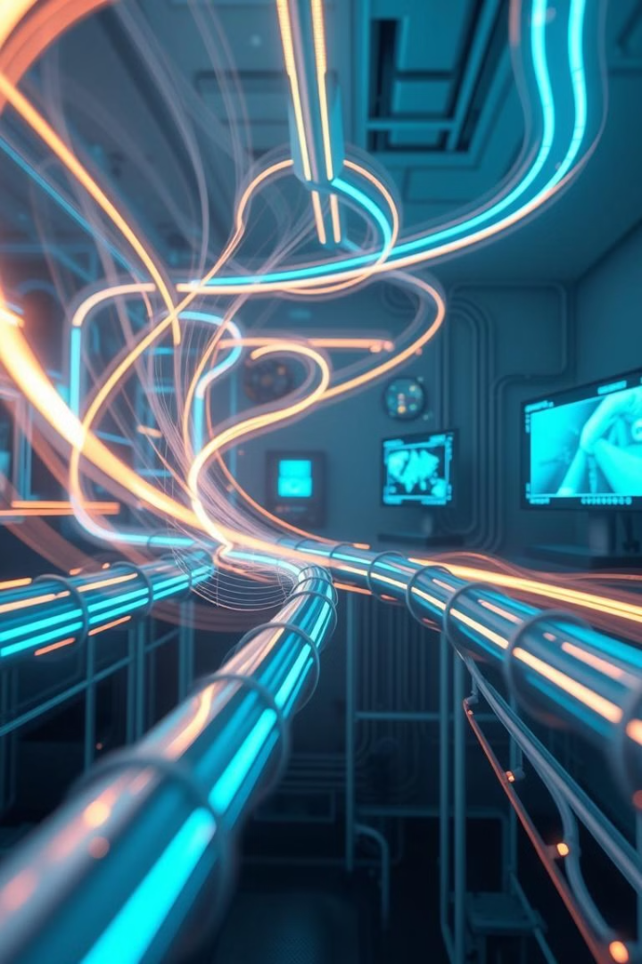




Our Cutting-Edge Technology Stack
AI Models
We use deep learning. It recognizes crack patterns. It also analyzes leak signatures.
Sound Wave Analysis
Acoustic sensors detect water flow. This helps pinpoint leak locations. This ensures accuracy.
Computer Vision
High-resolution Endoscopic cameras capture images. Image processing enhances crack visibility. This helps in analysis.
Edge Computing
Onboard processors handle data. This reduces the need for external connections. It ensures efficient data usage.

Slide 16

Key Features for Enhanced Performance
High-Resolution Endoscopic Cameras
AI-Driven Sound Processing
They provide clear images. They ensure detailed inspection.
It enhances leak detection. Accurate localization is achieved.
SD Card Storage
Real-Time Tracking
Footage is stored for analysis. No data is lost during inspection.
Tracks the robot's location. Marks issues with precision.

